Slide 1
story 1
File created on: 10/30/2023 4:55:32 AM

Slide 2
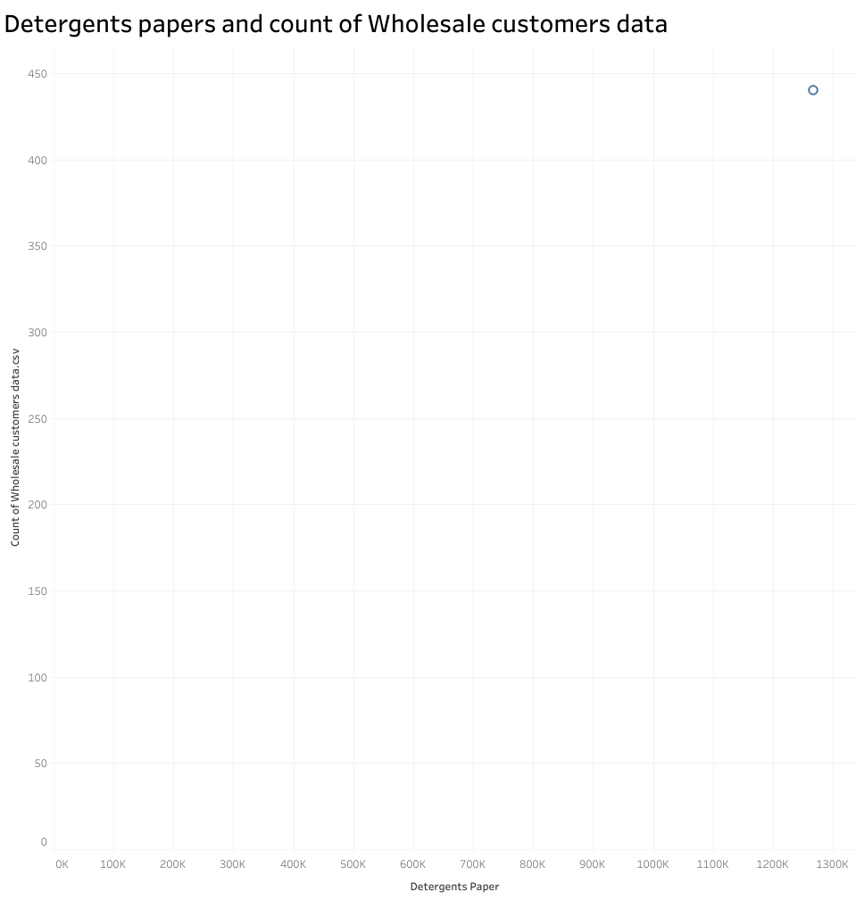

Slide 3
